Slide 1
Power BI – Consuming Uncommon Data Sources
Stan Bice

Slide 2
About Stan Bice
Senior Database Administrator, Johns Hopkins Center for Talented Youth
Over 25 years of software development experience
Past 10+ years focused on database, data warehouse and business intelligence development
Spoken at user groups and code camps, and participated in give camps
Technical reviewer with Manning Press
MCITP Business Intelligence Developer 2008
Facebook, LinkedIn, Instagram and Twitter (@StanBice3)
Honorary Life Member of Glenn Dale Volunteer Fire Association

Slide 3
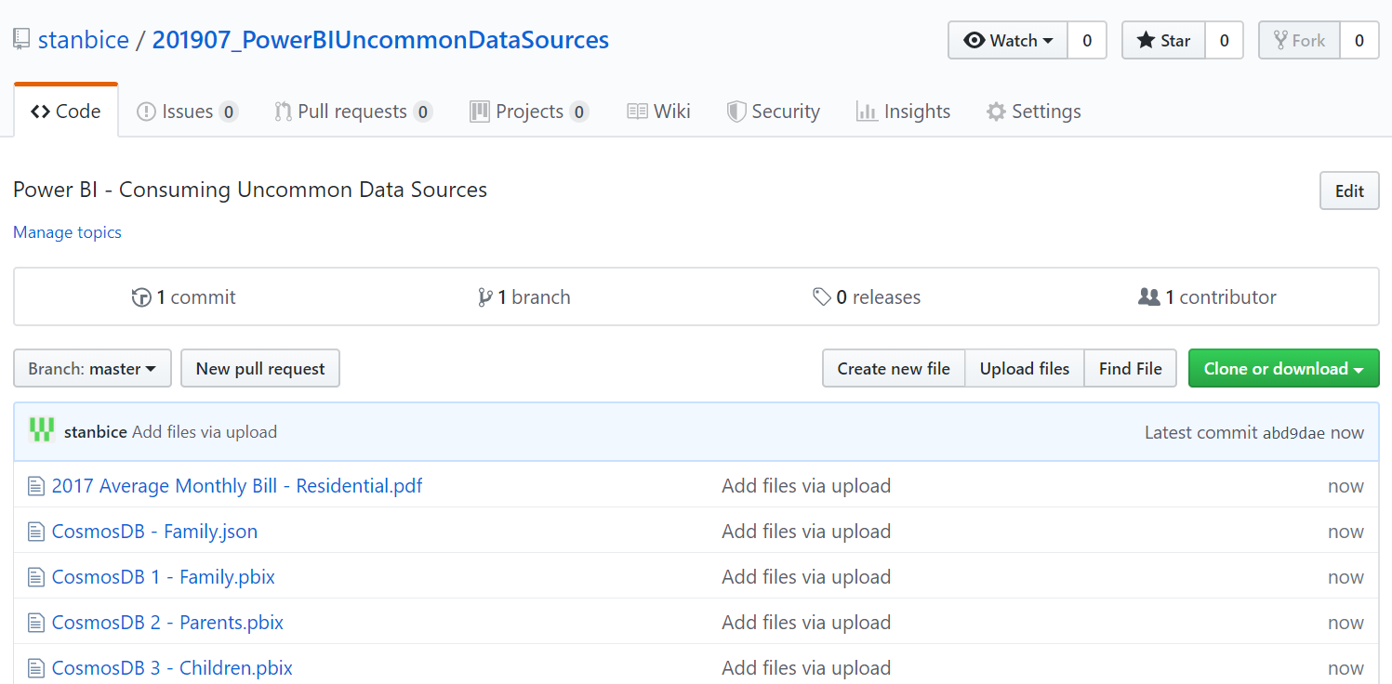
GitHub
https://github.com/stanbice

Slide 4
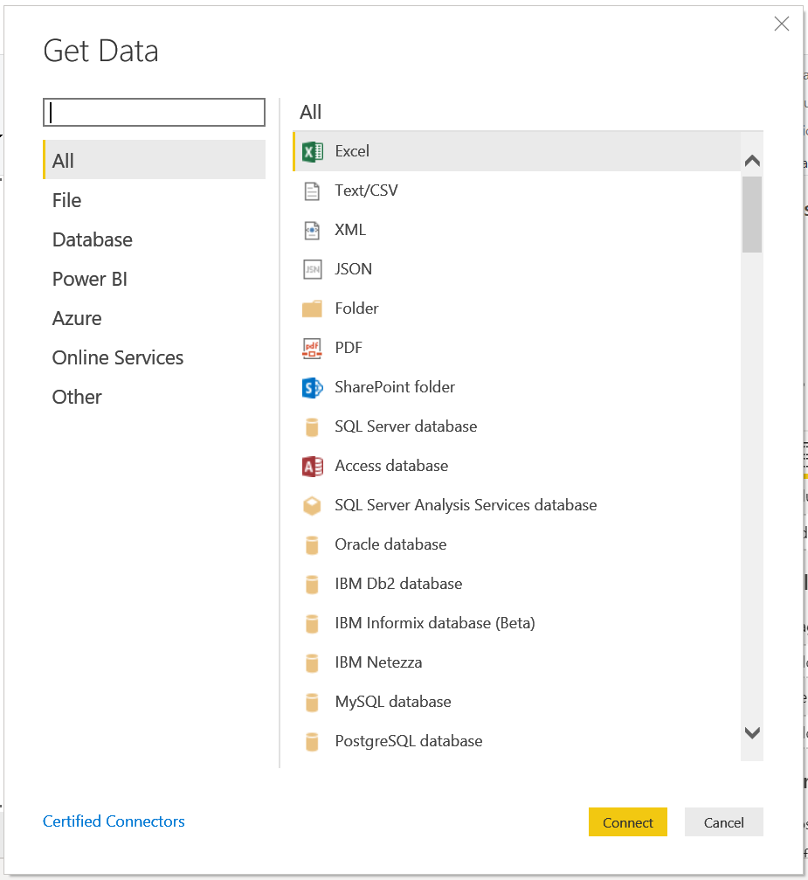
Data Sources are PLENTIFUL!!!

Slide 5
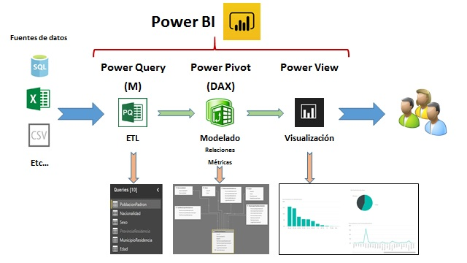
Power BI Workflow

Slide 6
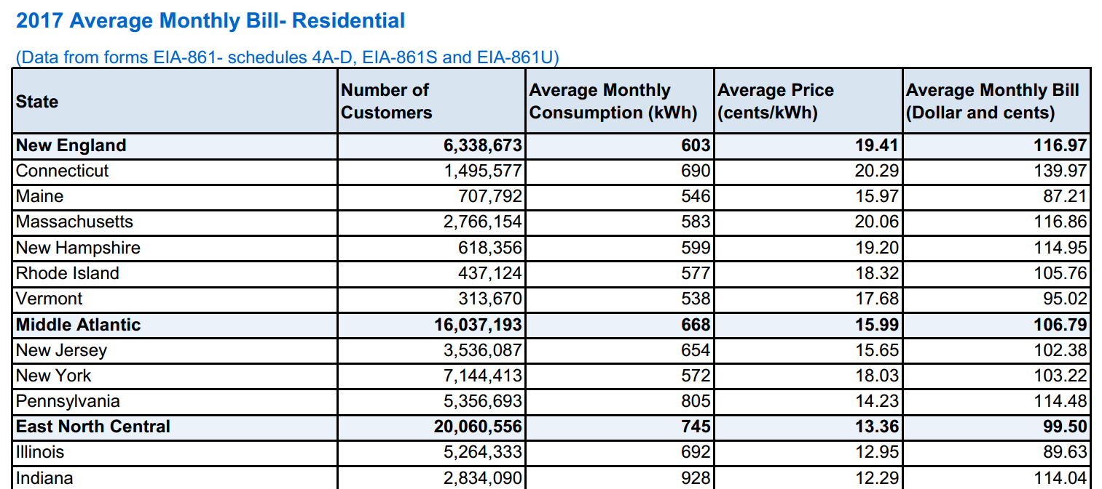
PDF

Slide 7

PDF Demo

Slide 8
Structures in Power Query Formula Language (M)
https://radacad.com/basics-of-value-structures-in-m-power-query-formula-language

Slide 9
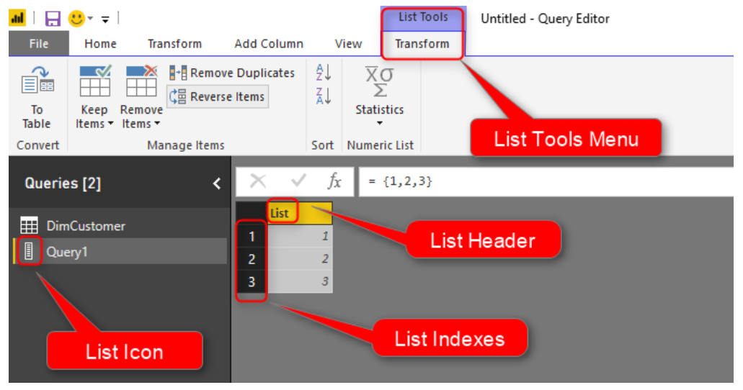
Structures in Power Query Formula Language (M)
List

Slide 10
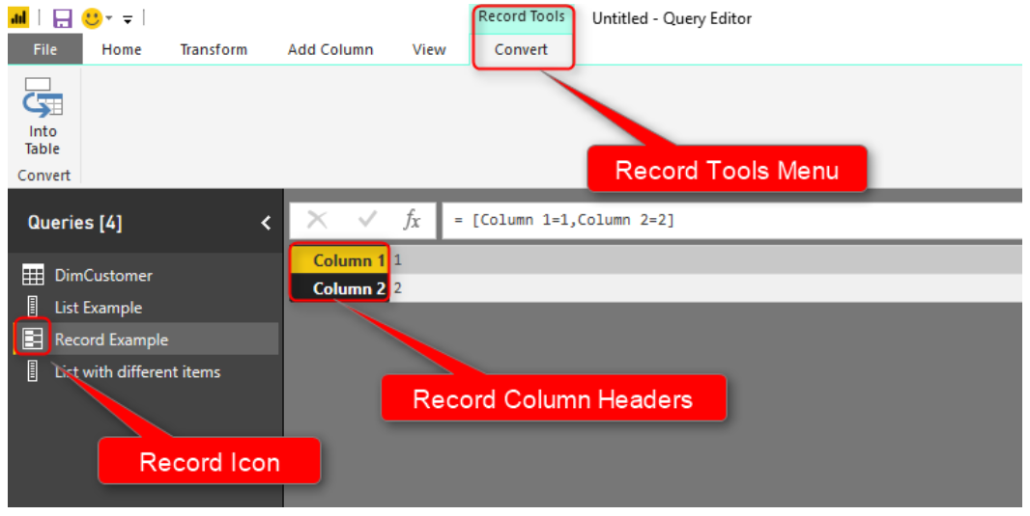
Structures in Power Query Formula Language (M)
Record

Slide 11
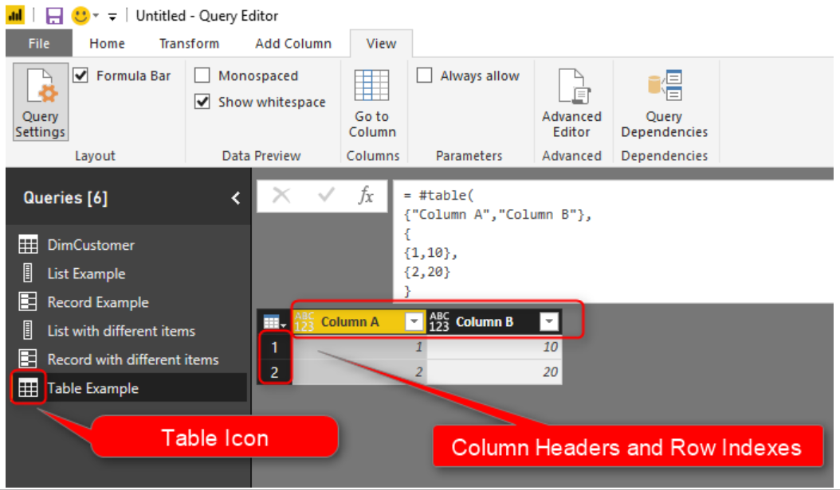
Structures in Power Query Formula Language (M)
Table

Slide 12

Document Databases (Azure Cosmos DB)
https://docs.microsoft.com/en-us/azure/cosmos-db/sql-query-getting-started

Slide 13
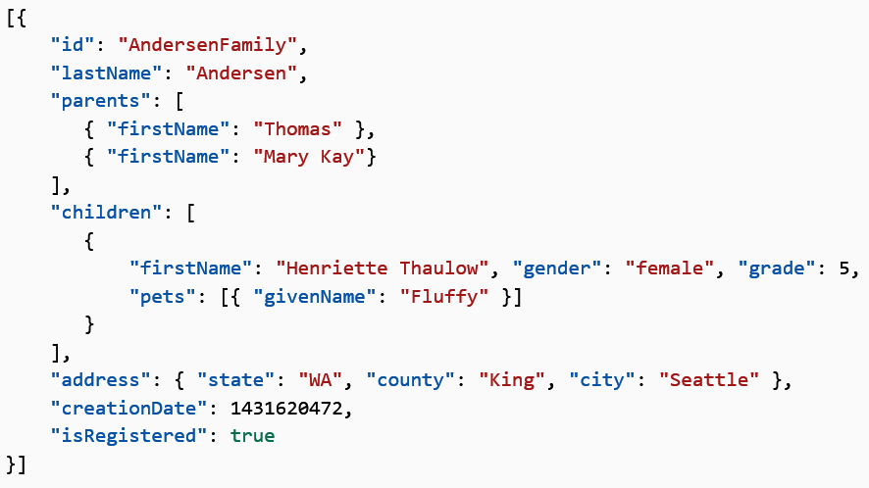
Document Databases (Azure Cosmos DB)
https://docs.microsoft.com/en-us/azure/cosmos-db/sql-query-getting-started

Slide 14
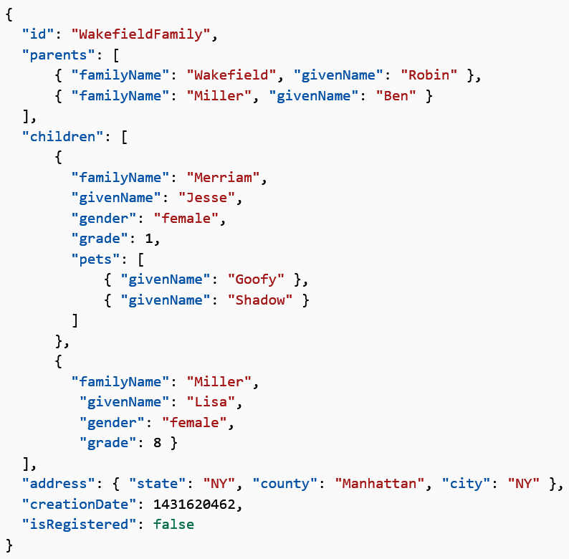
Document Databases (Azure Cosmos DB)

Slide 15
Azure Cosmos DB Demo

Slide 16
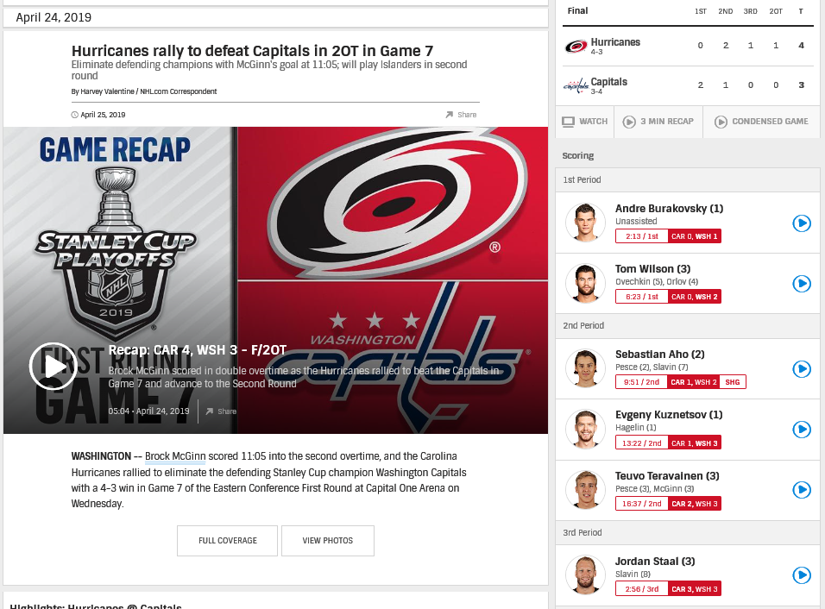
REST API

Slide 17
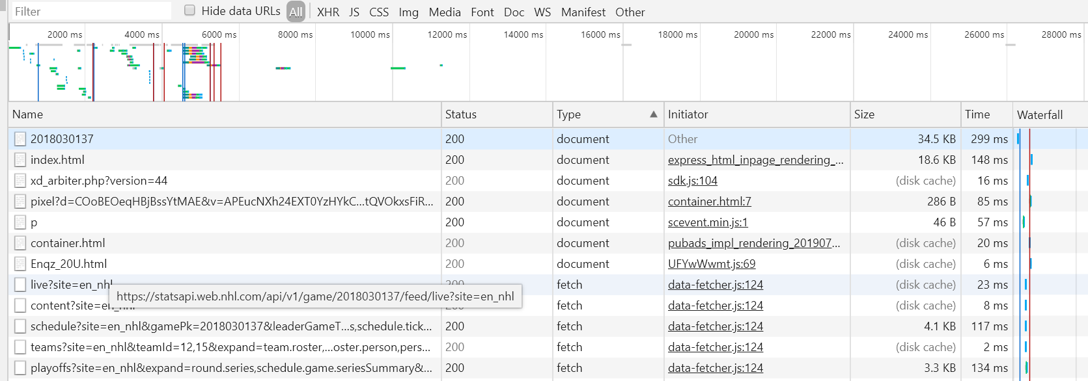
REST API
Chrome Developer Tools

Slide 18
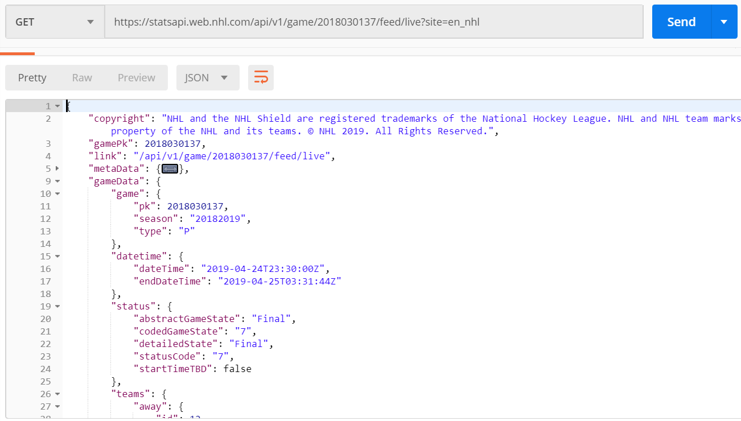
REST API
Postman

Slide 19
REST API Demo

Slide 20

Power BI - Resources
Online Book (Free) – Power BI from Rookie to Rock Star
http://radacad.com/online-book-power-bi-from-rookie-to-rockstar
DAX Patterns
https://www.daxpatterns.com/
YouTube – Power BI Jedi
https://www.youtube.com/watch?v=r0Qk5V8dvgg
Microsoft Power BI Blog
https://powerbi.microsoft.com/en-us/blog/

Slide 21
Power BI - Resources
Power BI YouTube Channel
https://www.youtube.com/user/mspowerbi
Guy in a Cube YouTube Channel
https://www.youtube.com/channel/UCFp1vaKzpfvoGai0vE5VJ0w
Power BI Udemy course
https://www.udemy.com/course/microsoft-power-bi-up-running-with-power-bi-desktop/

